Slide 1
Microsoft Commercial Marketplace
Microsoft Skilling

Slide 2
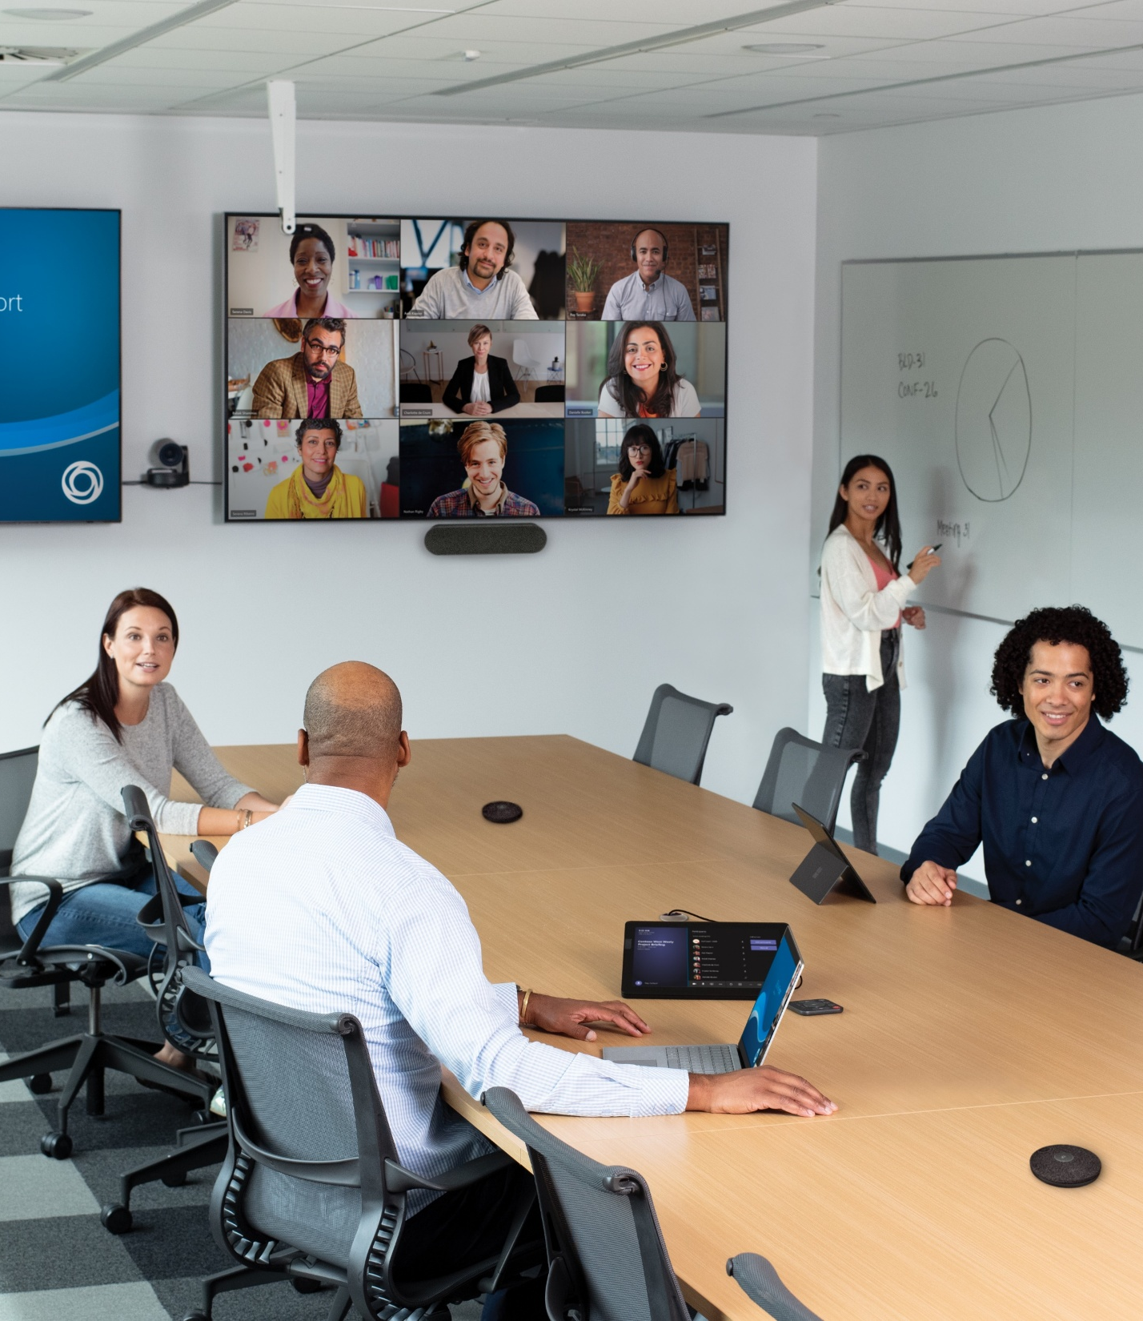
Learning objectives
In this workshop, you will participate in lecture and group activities to accomplish the following items:
Accessing and navigating the Microsoft Marketplace.
Searching and deploying solutions in the Microsoft Marketplace.
Integration of procurement applications into the Microsoft Marketplace.
Microsoft Marketplace governance and permissions.
Managing purchases and setting up limits.
Notes:
Review the learning objects with the participants.

Slide 3
What to expect
This workshop includes:
This workshop does not include:
Content with documented use cases and discussion topics
Documented exercises to follow along with the instructor
Hands-on lab experience
Shared hands-on lab environment (aka OpenHack)
Lecture without interaction

Slide 4

Day One
9:00 | 20 minutes | Kick-off and overview
9:30 | 60 minutes | What is Microsoft Marketplace
10:30 | 90 minutes | Purchasing in Marketplace
12:00 | 45 minutes | Lunch
12:45 | 165 minutes | Labs – Deployment of resources and SaaS offerings through the Marketplace
15:00 | 20 minutes | Wrap-up – General Channel
Agenda
Day Two
9:00 | 30 minutes | Day One review and questions
9:30 | 60 minutes | Integrating Marketplace with Procurement Systems
10:30 | 60 minutes | Private offers overview
12:00 | 45 minutes | Lunch
12:45 | 60 minutes | Private Marketplace overview
13:45 | 105 minutes | Lab - Setting up and using a private Marketplace
15:00 | 20 minutes | Wrap-up
Notes:
NOTE: Your start time may vary. Please fill in time zone for this delivery.
SAY:
Training is x hours long.
There are no scheduled breaks, take when needed. There is a 45-minute lunch.
Head Coach will start the workshop in the General Channel and wrap up the workshop at the end of the day in the General Channel.
The rest of the day, the students will work in their individual TEAM Channels with you as the other coaches leading them through activities and monitoring the schedule.
Coach should do a high-level walk-through of the agenda and what is happening at each of the lab modules.

Slide 5
Day One
9:00 | 20 minutes | Kick-off and overview
9:30 | 60 minutes | What is Microsoft Marketplace
10:30 | 20 minutes | Break
11:10 | 90 minutes | Purchasing in Marketplace
12:40 | 45 minutes | Lunch
13:25 | 90 minutes | Lab – Deployment of resources and
14:55 | 20 minutes | Break
15:25 | 80 minutes | Lab - SaaS offerings through the Marketplace
16:45 | 15 minutes | Wrap-up – General Channel
Agenda
Notes:
NOTE: Your start time may vary. Please fill in time zone for this delivery.
SAY:
Training is x hours long.
There are no scheduled breaks, take when needed. There is a 45-minute lunch.
Head Coach will start the workshop in the General Channel and wrap up the workshop at the end of the day in the General Channel.
The rest of the day, the students will work in their individual TEAM Channels with you as the other coaches leading them through activities and monitoring the schedule.
Coach should do a high-level walk-through of the agenda and what is happening at each of the lab modules.

Slide 6
Day One: Microsoft Marketplace overview and purchasing

Slide 7
Introduction
This module will help you to understand Microsoft Commercial Marketplace and purchasing solutions.
After completing this module, you’ll be able to:
Explain the use and benefits of Microsoft Marketplace.
Understand the ways to purchase solutions through Marketplace.
Use the Marketplace to purchase Azure resources.
Use the Marketplace to purchase SaaS applications.
Deploy resources and applications from the Marketplace.

Slide 8
Introduction to Marketplace (60 minutes)

Slide 9
What is the Microsoft Commercial Marketplace?
Cloud-based
On-demand
Microsoft services
Third-party Microsoft partner solutions
Independent software vendor (ISV) partners
Global system integrators (GSI) partners – for consulting and managed services
Notes:
Azure Marketplace overview - Microsoft marketplace | Microsoft Learn

Slide 10
Who uses Marketplace?
Customers
Searchable tool
Trial licenses available
Easily buy and deploy solutions
Use existing Microsoft purchase agreements for consolidated invoice
Partners
Test solutions in Microsoft Azure infrastructure
Create your own offers for an additional sales and marketing channel
Reach more customers
Notes:
Azure Marketplace overview - Microsoft marketplace | Microsoft Learn

Slide 11
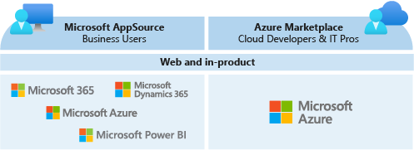
AppSource vs. Marketplace
Marketplace is specific to Azure
Microsoft AppSource is for:
Azure
M365
Microsoft Dynamics 365
Microsoft Power BI
Notes:
Azure Marketplace overview - Microsoft marketplace | Microsoft Learn

Slide 12
Marketplace online store
Apps
Consulting Services
Featured solutions
Accessible through marketplace link:
https://azuremarketplace.microsoft.com/
Accessible through Azure portal link:
https://portal.azure.com
Browse, Search, or Filter to find apps or consulting services

Slide 13
Exercise – Search for Free Apps on Windows OS
Go to the Azure Marketplace
Use the Browse apps to select IT & Management tools
Filter the Operating System to Windows
Filter the Pricing Model to Free
Find an app
Mark it as a favorite

Slide 14
Exercise – Search for Paid Apps on Windows
Go to the Azure Marketplace
Use the Browse apps to select Security
Filter the Pricing Model to Pay as You Go
Find an app
Mark it as a favorite

Slide 15
Exercise – Search for Free Consulting Services
Go to the Marketplace
1
Use the Browse apps to select Security
2
Filter the Service Types to Assessment
3
Filter the Pricing Model to Free
4
Find a consulting service
5
Mark it as a favorite

Slide 16
Exercise – Search for Paid Consulting Services
Go
Go to the Azure Marketplace
Use
Use the Browse apps to select Security
Filter
Filter the Service Types to Workshop
Filter
Filter the Pricing Model to Paid
Find
Find a consulting service
Mark
Mark it as a favorite

Slide 17
15 minute break

Slide 18
Creating Offers and Purchasing in Marketplace

Slide 19
How does purchasing work in Azure Marketplace?
Listing (Contact Me)
Free Trial
Bring Your Own License (BYOL) - Get it Now
Transaction – Get it Now
Bill to Microsoft account
Process with credit card
Link to provider CRM
Reach out to interested customers
Try before you buy
Test drive software
Use current license
Protects your existing investment in software
Notes:
Azure Marketplace overview - Microsoft marketplace | Microsoft Learn

Slide 20
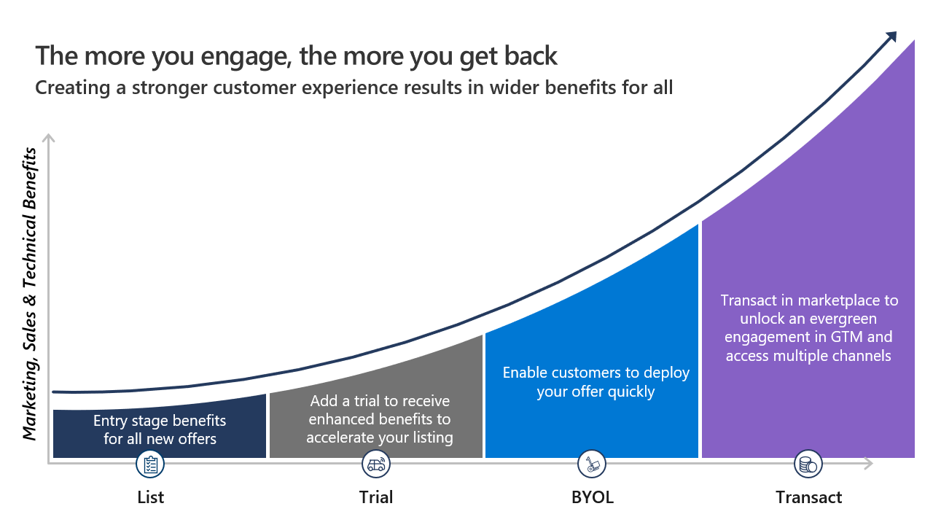
Marketplace Rewards
Published offers receive different tiers of support based on the transaction type.
https://aka.ms/joinmarketplace

Slide 21
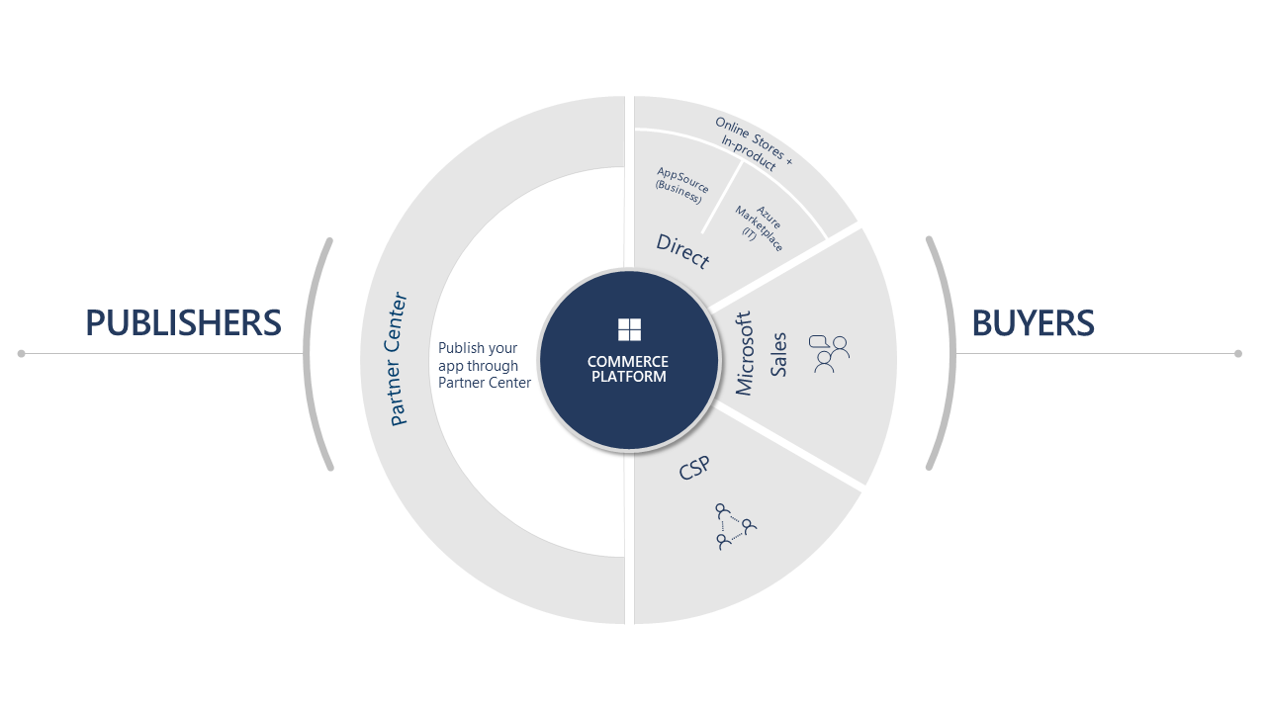
Purchasing Options
Online stores
Within Microsoft Products
Through CSP partners
Microsoft sales through co-sell
Notes:
Commercial marketplace sales channels - Training | Microsoft Learn

Slide 22
Drawing Customers to Your Listing
Free trials
Plan and pricing options
Selling through Microsoft
Notes:
Commercial marketplace sales channels - Training | Microsoft Learn

Slide 23
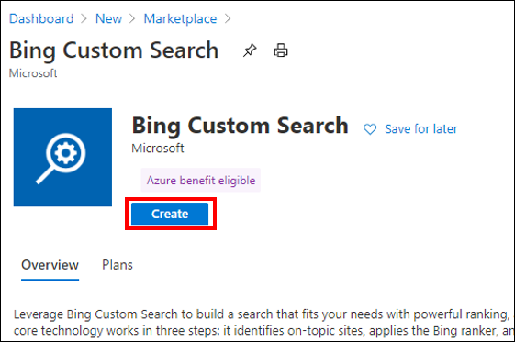
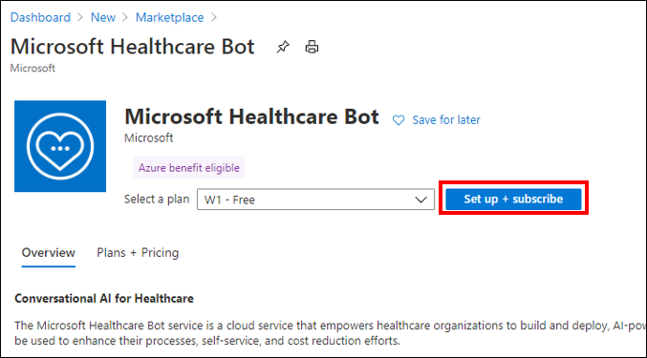
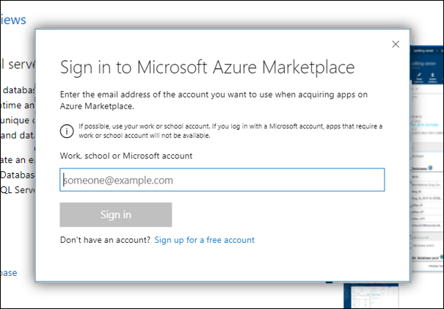
Azure Marketplace Purchasing
Simplified procurement
Credit card
Microsoft account
Permission to purchase
RBAC permissions
Subscription owner or contributor

Slide 24
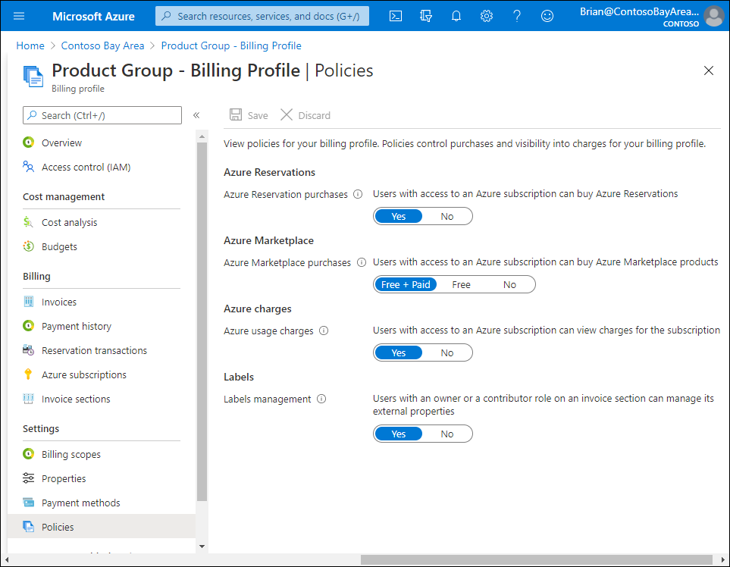
Purchase Policy Management
Purchase policy management
Azure subscription administrator manages
Billing profiles
Policies manage user purchases
Azure Reservations
Azure Marketplace
Free + Paid
Free
No
Labels

Slide 25
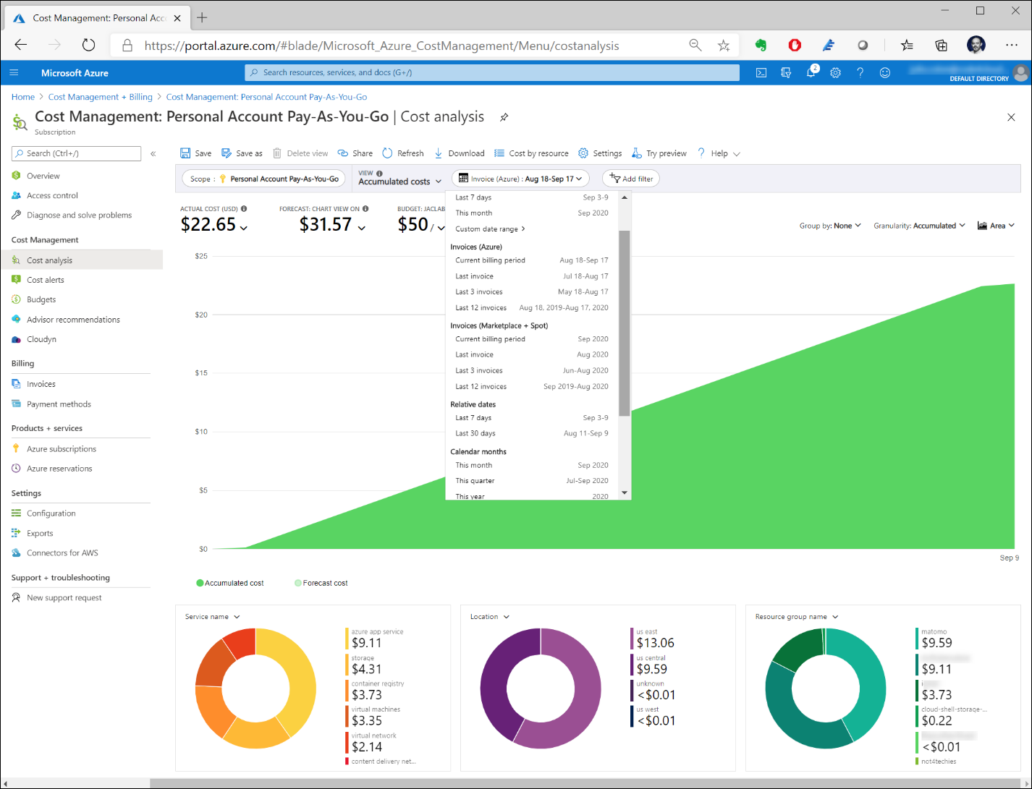
Cost Management
Cost management
Set budgets
Spending limits
Analyze costs and spending
Notes:
Purchasing software and solutions from Azure Marketplace - Microsoft marketplace | Microsoft Learn

Slide 26
Purchase Validation
Purchase validation checks
Failure to purchase reasons
Governs the policies that have been put in place
Notes:
Purchasing software and solutions from Azure Marketplace - Microsoft marketplace | Microsoft Learn

Slide 27
Purchasing Azure Application
Requirements
Have an Azure subscription
Have correct role assignment to purchase
Types of plans
Solution template (ARM template)
Managed application
Steps to purchase
https://portal.azure.com
Notes:
Commercial marketplace sales channels - Training | Microsoft Learn

Slide 28
Purchase and Deploy an Azure Application
Walk through demo
Lab exercise in the afternoon
Notes:
Sign in to Azure portal at https://portal.azure.com.
Under Azure services, select + Create a resource.
In the upper-right of the page, next to Popular Marketplace products, select See more in Marketplace.
To filter the results on Azure Application offers, select the Product Type filter near the top of the page, and then select Azure Applications.
You can optionally filter the results using the following filters.
Filter group
Description
Pricing
You can filter on the following: Free – free plan, the software is provided with no additional cost, not including the cost associated with the VM instance type. Free trial - Azure virtual machine plans allow for 1, 3, or 6-month free trials. Once the free trial is over the Pay as you Go price will be charged. Bring your own license – contact the publisher to get the license for using the software Pay as you go - usage-based pricing model, can be charged per core, per core size, or per market (customer sold-to address) and core size
Publisher Type
Select Microsoft, Partners, or both
Publisher name
Filter the products based on the publisher's name
You can optionally select a category on the left-side of the page to further filter the results.
To see only offers that are eligible for the Azure benefit program, select the Azure benefit eligible only check box. To learn more about this benefit program, see Azure consumption commitment benefit.
Select the Azure Application offer you want.
If the offer has more than one plan, you can see them on the Plans + Pricing tab.
Select Create. The Create Offer Name page appears.
On the Basics tab, under Project details, make sure the subscription you want the VM for is selected. Then next to Resource group, do one of the following:
From the Resource group list, select an existing resource group.
Below the Resource group list, select Create new. Then, in the dialog box that appears, enter a name for the resource group and select OK.
Complete any remaining fields on the page, and then select Review + create. Other input fields in the Marketplace experience vary between publishers and offers. Each offer might collect different input based on it's needs.

Slide 29
Purchasing Azure resources
Requirements
Have an Azure subscription
Have permission to purchase from Azure Marketplace
Images have different costs
Size of VM – vCores, RAM, drive space
Operating systems
Windows Server
Windows Client
Linux distributions
Steps to purchase
https://portal.azure.com
Notes:
Commercial marketplace sales channels - Training | Microsoft Learn

Slide 30
Purchase and Deploy an Azure Virtual Machine
Walk through demo
Lab exercise in the afternoon
Notes:
Sign in to the Azure portal at https://portal.azure.com.
Under Azure services, select + Create a resource.
In the upper-right of the page, next to Popular Marketplace products, select See more in Marketplace.
To filter the results on virtual machine offers, select the Product Type filter near the top of the page, and then select Virtual Machine.
You can optionally filter the results using the following filters.
Filter group
Description
Pricing
You can filter on the following: Free – free plan, the software is provided with no additional cost, not including the cost associated with the VM instance type Free trial - Azure virtual machine plans allow for 1, 3, or 6-month free trials, once the free trial is over the Pay as you Go price will be charged Bring your own license – contact the publisher to get the license for using the software Pay as you go - usage-based pricing model, can be charged per vCPU, per vCPU size, or per market (customer sold-to address) and vCPU size
Operating System
Filter by the OS the VM image is using
Publisher Type
Select Microsoft, Partners, or both
Publisher name
Filter the products based on the publisher's name
You can optionally select a category on the left-side of the page to further filter the results.
To see only offers that are eligible for the Azure benefit program, select the Azure benefit eligible only check box. To learn more about this benefit program, see Azure consumption commitment benefit.
Select the VM offer you want.
If the offer has more than one plan, you can see them on the Plans + Pricing tab.
Select Create. The Create a virtual machine page appears.
On the Basics tab, under Project details, make sure the subscription you want the VM for is selected. Then next to Resource group, do one of the following:
From the Resource group list, select an existing resource group.
Below the Resource group list, select Create new. Then, in the dialog box that appears, enter a name for the resource group and select OK.
Under Instance details, do the following:
In the Virtual machine name box, enter the name you want for this VM.
From the Region list, choose the region you want.
From the Size list, select the VM size you want.
Complete the remaining fields on the page. Then select Review + create.
Purchase a VM using search
Sign in to the Azure portal at https://portal.azure.com.
In the search box, enter virtual machines.
Under Services, select Virtual machines.
On the Virtual machines page, select + Create > + Virtual machine. The Create a virtual machine page appears.
On the Basics tab, under Project details, make sure the subscription you want the VM for is selected. Then next to Resource group, do one of the following:
From the Resource group list, select an existing resource group.
Below the Resource group list, select Create new. Then, in the dialog box that appears, enter a name for the resource group and select OK.
Under Instance details, do the following:
In the Virtual machine name box, enter the name you want for this VM.
From the Region list, choose the region you want.
The Image list holds recently used images and Marketplace images to help you get started. Do one of the following:
Select a VM image from the Image list. Complete the fields and then go to step 12.
Below the Image list, select See all images to open the Marketplace experience.
You can use the left-nav to help you find the VM you're looking for. The left-nav has the following sections:
My Items – VM images created by you or shared with you. To learn more, see Store and share images in an Azure Compute Gallery.
Marketplace – Recently created products and Marketplace Private products.
Categories – You can filter Marketplace products by category.
My Images - To access VM images created by you.
Shared Images - To access VM images shared with you. To learn more, see Store and share images in an Azure Compute Gallery.
Community Images (PREVIEW) - To access VM images shared by an Azure subscription owner within their Azure subscription.

Slide 31
Purchasing SaaS applications
Requirements
Have an Azure subscription
Have permission to purchase from Marketplace
Discovery of SaaS offers through filters
Offer type
Private offers
Overview
Plans + Pricing
Usage information + Support
Ratings and Reviews
Billing models
Monthly
Annual (multi-year)

Slide 32
Purchase and Subscribe to a SaaS offer
Walk through demo
Subscription and configuration
https://learn.microsoft.com/en-us/marketplace/purchase-saas-offer-in-azure-portal#saas-subscription-and-configuration
Lab exercise in the afternoon
Notes:
Here are the steps you take to purchase a SaaS offer:
On the product page, select a plan that meets your needs, and then select Set up + subscribe.
You're redirected to the Basics tab, where you:
Define which subscription you want to use for billing. The Azure subscription that you use should have a valid purchase method defined for it. You should have the right level of permissions, or have a resource group under that subscription with the right level of permissions. The billing country/region of the subscription should be a country/region where the offer is available for purchase. Azure subscriptions without a valid payment method (for example, an MSDN subscription) can only be used to purchase free plans.
Note
The following Azure subscriptions can't be used to purchase SaaS: Student, Visual Studio Enterprise, or Free credit.
Choose or create a resource group to hold the SaaS application.
Type a name for the SaaS subscription, to easily identify it later. You can't change this name after you have purchased the SaaS subscription.
Under Plan, you'll see the plan you selected in the product details page (PDP). If you haven't made an active selection in the PDP, you'll see the default plan. You can change your selection by selecting the Change plan link. Then select the plan and billing term you want.
Note
You can only change to another plan that has the same billing term and payment option. For more information, see SaaS subscription lifecycle management.
In cases where the pricing model is per user, you'll be required to specify the number of users. The price that you see will change based on the subscription, plan, term, and payment frequency that you've selected.
Proceed to the Tags tab. Tags are key/value pairs that you can define. You place tags directly on a resource or a resource group, which helps you find your SaaS resource later on. Azure currently supports up to 50 tags per resource and resource group. Place tags on a resource at the time of creation, or add them to an existing resource.
Continue to Review + Subscribe to go through the offer and plan details.
Review the terms of use, amendments, and privacy policy of the publisher, and also Azure Marketplace.
You might be asked to add your contact details.
Review details for Basics and Tags.
Upon confirmation, select Subscribe.

Slide 33
Programmatic Deployment of Marketplace products
Prerequisites
Install Azure PowerShell module
https://learn.microsoft.com/en-us/powershell/azure/get-started-azureps
Connect to Azure with Connect-AZAccount command
Usage Information + Support
Information needed for PowerShell
Publisher ID
Product ID
Plan ID
Other deployment options
Azure CLI
Terraform
Notes:
Programmatic deployment of Marketplace products - Microsoft marketplace | Microsoft Learn

Slide 34
SaaS Subscription Management
Managing purchases depends on the method of purchase
Purchase in Azure portal, manage in Azure portal
Purchase in AppSource, manage in Microsoft 365 Admin Center
Microsoft Partner solutions may be in Microsoft portals in their own admin portal
Changing plans
Requires Owner or Contributor role permissions
Notes:
Software as a Service (SaaS) subscription lifecycle management - Microsoft marketplace | Microsoft Learn

Slide 35
Billing and Invoicing
Multiple currencies are supported
Recurring billing and auto-renew
Invoices are emailed monthly
Enterprise Agreement customers receive a combined Azure consumption and Marketplace invoice
Marketplace customers receive a bill only from Marketplace
Charges are calculated on the date of purchase

Slide 36
Consumption Benefits

Slide 37
Subscription Transfers

Slide 38
45 minute break

Slide 39
Afternoon: Hands-on Labs

Slide 40
Labs
Purchase and Deploy an Azure Application
Deploying Azure Resources
Deploying SaaS offering
Deploying third-party resources

Slide 41
Purchase and Deploy an Azure Application
Lab exercise
Lab to be created in markdown
Notes:
Sign in to Azure portal at https://portal.azure.com.
Under Azure services, select + Create a resource.
In the upper-right of the page, next to Popular Marketplace products, select See more in Marketplace.
To filter the results on Azure Application offers, select the Product Type filter near the top of the page, and then select Azure Applications.
You can optionally filter the results using the following filters.
Filter group
Description
Pricing
You can filter on the following: Free – free plan, the software is provided with no additional cost, not including the cost associated with the VM instance type. Free trial - Azure virtual machine plans allow for 1, 3, or 6-month free trials. Once the free trial is over the Pay as you Go price will be charged. Bring your own license – contact the publisher to get the license for using the software Pay as you go - usage-based pricing model, can be charged per core, per core size, or per market (customer sold-to address) and core size
Publisher Type
Select Microsoft, Partners, or both
Publisher name
Filter the products based on the publisher's name
You can optionally select a category on the left-side of the page to further filter the results.
To see only offers that are eligible for the Azure benefit program, select the Azure benefit eligible only check box. To learn more about this benefit program, see Azure consumption commitment benefit.
Select the Azure Application offer you want.
If the offer has more than one plan, you can see them on the Plans + Pricing tab.
Select Create. The Create Offer Name page appears.
On the Basics tab, under Project details, make sure the subscription you want the VM for is selected. Then next to Resource group, do one of the following:
From the Resource group list, select an existing resource group.
Below the Resource group list, select Create new. Then, in the dialog box that appears, enter a name for the resource group and select OK.
Complete any remaining fields on the page, and then select Review + create. Other input fields in the Marketplace experience vary between publishers and offers. Each offer might collect different input based on it's needs.

Slide 42
Purchase and Deploy an Azure Virtual Machine
Lab exercise
Lab to be created in markdown
Notes:
Sign in to the Azure portal at https://portal.azure.com.
Under Azure services, select + Create a resource.
In the upper-right of the page, next to Popular Marketplace products, select See more in Marketplace.
To filter the results on virtual machine offers, select the Product Type filter near the top of the page, and then select Virtual Machine.
You can optionally filter the results using the following filters.
Filter group
Description
Pricing
You can filter on the following: Free – free plan, the software is provided with no additional cost, not including the cost associated with the VM instance type Free trial - Azure virtual machine plans allow for 1, 3, or 6-month free trials, once the free trial is over the Pay as you Go price will be charged Bring your own license – contact the publisher to get the license for using the software Pay as you go - usage-based pricing model, can be charged per vCPU, per vCPU size, or per market (customer sold-to address) and vCPU size
Operating System
Filter by the OS the VM image is using
Publisher Type
Select Microsoft, Partners, or both
Publisher name
Filter the products based on the publisher's name
You can optionally select a category on the left-side of the page to further filter the results.
To see only offers that are eligible for the Azure benefit program, select the Azure benefit eligible only check box. To learn more about this benefit program, see Azure consumption commitment benefit.
Select the VM offer you want.
If the offer has more than one plan, you can see them on the Plans + Pricing tab.
Select Create. The Create a virtual machine page appears.
On the Basics tab, under Project details, make sure the subscription you want the VM for is selected. Then next to Resource group, do one of the following:
From the Resource group list, select an existing resource group.
Below the Resource group list, select Create new. Then, in the dialog box that appears, enter a name for the resource group and select OK.
Under Instance details, do the following:
In the Virtual machine name box, enter the name you want for this VM.
From the Region list, choose the region you want.
From the Size list, select the VM size you want.
Complete the remaining fields on the page. Then select Review + create.
Purchase a VM using search
Sign in to the Azure portal at https://portal.azure.com.
In the search box, enter virtual machines.
Under Services, select Virtual machines.
On the Virtual machines page, select + Create > + Virtual machine. The Create a virtual machine page appears.
On the Basics tab, under Project details, make sure the subscription you want the VM for is selected. Then next to Resource group, do one of the following:
From the Resource group list, select an existing resource group.
Below the Resource group list, select Create new. Then, in the dialog box that appears, enter a name for the resource group and select OK.
Under Instance details, do the following:
In the Virtual machine name box, enter the name you want for this VM.
From the Region list, choose the region you want.
The Image list holds recently used images and Marketplace images to help you get started. Do one of the following:
Select a VM image from the Image list. Complete the fields and then go to step 12.
Below the Image list, select See all images to open the Marketplace experience.
You can use the left-nav to help you find the VM you're looking for. The left-nav has the following sections:
My Items – VM images created by you or shared with you. To learn more, see Store and share images in an Azure Compute Gallery.
Marketplace – Recently created products and Marketplace Private products.
Categories – You can filter Marketplace products by category.
My Images - To access VM images created by you.
Shared Images - To access VM images shared with you. To learn more, see Store and share images in an Azure Compute Gallery.
Community Images (PREVIEW) - To access VM images shared by an Azure subscription owner within their Azure subscription.

Slide 43
Purchase and Subscribe to a SaaS offer
Lab exercise
Lab to be created in markdown
Notes:
Here are the steps you take to purchase a SaaS offer:
On the product page, select a plan that meets your needs, and then select Set up + subscribe.
You're redirected to the Basics tab, where you:
Define which subscription you want to use for billing. The Azure subscription that you use should have a valid purchase method defined for it. You should have the right level of permissions, or have a resource group under that subscription with the right level of permissions. The billing country/region of the subscription should be a country/region where the offer is available for purchase. Azure subscriptions without a valid payment method (for example, an MSDN subscription) can only be used to purchase free plans.
Note
The following Azure subscriptions can't be used to purchase SaaS: Student, Visual Studio Enterprise, or Free credit.
Choose or create a resource group to hold the SaaS application.
Type a name for the SaaS subscription, to easily identify it later. You can't change this name after you have purchased the SaaS subscription.
Under Plan, you'll see the plan you selected in the product details page (PDP). If you haven't made an active selection in the PDP, you'll see the default plan. You can change your selection by selecting the Change plan link. Then select the plan and billing term you want.
Note
You can only change to another plan that has the same billing term and payment option. For more information, see SaaS subscription lifecycle management.
In cases where the pricing model is per user, you'll be required to specify the number of users. The price that you see will change based on the subscription, plan, term, and payment frequency that you've selected.
Proceed to the Tags tab. Tags are key/value pairs that you can define. You place tags directly on a resource or a resource group, which helps you find your SaaS resource later on. Azure currently supports up to 50 tags per resource and resource group. Place tags on a resource at the time of creation, or add them to an existing resource.
Continue to Review + Subscribe to go through the offer and plan details.
Review the terms of use, amendments, and privacy policy of the publisher, and also Azure Marketplace.
You might be asked to add your contact details.
Review details for Basics and Tags.
Upon confirmation, select Subscribe.

Slide 44
Summary
What you learned:
Explain the use and benefits of Microsoft Marketplace.
Understand the ways to purchase solutions through Marketplace.
Use the Marketplace to purchase Azure resources.
Use the Marketplace to purchase SaaS applications.
Deploy resources and applications from the Marketplace.

